Slide 1

HTTP, HTTPS, SSL
M.S.Mohan Sivam

Slide 2

What is HTTP
The Hypertext Transfer Protocol (HTTP) is the basic communication protocol that both clients and servers must implement in order to be able to communicate.
The protocol transfers information between the browser and the server in clear text, allowing the network, through which the information passes, to see the information transmitted.

Slide 3

What is HTTPS
For the security concern, HTTP Secure (HTTPS) was introduced, allowing the client and the server to first establish an encrypted communication channel, and then pass the clear text HTTP messages through it, effectively protecting them from eavesdropping.

Slide 4
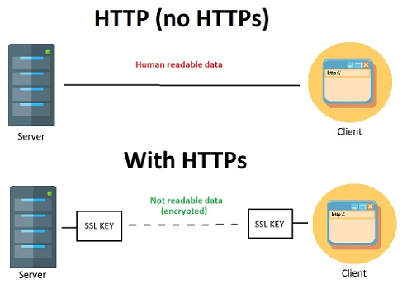
HTTP vs HTTPS

Slide 5
Why SSL Cerificate?
Encrypts the traffic between a web server and a web browser.
Enhances Data Security.
Increases the trust of users.

Slide 6
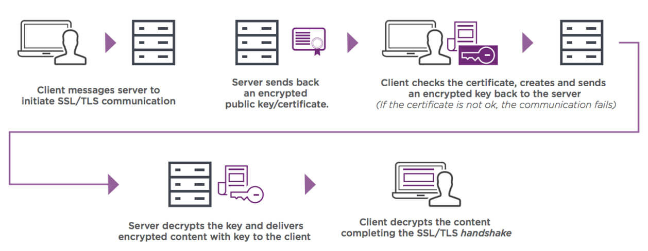
SSL Certificate Work Flow.

Slide 7
SSL Certificate Work Flow.
1. My Browser requests secure pages(HTTPS) from a Google Web server
2. Google sends its Public Key with SSL Certificate which is digitally signed by Third party CA.
3. Once the browser gets the certificate, it will check the issuer's digital signature to make sure the certificate is valid.
4. Once the Certificate's Signature is verified, the digital certificate is trusted.
5. Browser will create Symmetric Key, keeps one and share one copy to the webserver. this key will be encrypted by Webserver's Public Key.
6. When the Web server receives the Symmetric key, it uses its private to to decrypt it.

Slide 8
Installation
$yum install –y httpd
$yum install mod_ssl
$yum install openssl

Slide 9
Installation
$ openssl req -x509 -nodes -days 365 -newkey rsa:2048 -keyout server.key -out server.crt

Slide 10
Installation
Move the server.key and sever.crt to the above-mentioned path
sslcertificatefile /etc/pki/tls/certs/server.crt
sslcertificatekeyfile /etc/pki/tls/private/server.key

Slide 11
Installation
To editing the SSL config file:
[root@msmohansivam ~]# vi /etc/httpd/conf.d/ssl.conf
Uncomment the DocumentRoot and ServerName like as follows
DocumentRoot “/var/www/html”
ServerName 192.168.181.2:443
SSLEngine on
SSLCertificateFile /etc/pki/tls/certs/ca.crt
SSLCertificateKeyFile /etc/pki/tls/private/ca.key
Restart the httpd
[root@msmohansivam ~]# systemctl restart httpd

Slide 12
The process of purchasing and installing a third-party certificate.
Generate a private key.
Use the private key plus some identifying information to generate a Certificate Signing Request (CSR).
Send the Certificate Signing Request to the certificate authority.
Complete one or more steps for confirmation and identification as determined by the Certificate Authority.
Install the certificate provided by the certificate authority along with the Certificate Authority bundle if one is provided.

Slide 13
Thank You

